Slide 1
CEH and CISSP
Certification Prep Day 3

Slide 2
Class Objectives
By the end of class, you will be able to:
Prepare for the CEH exam.
Understand the requirements of the CISSP exam.
Correctly answer CEH and CISSP practice questions.

Slide 3

The first half of today’s class will focus on the CEH and CISSP exams and the types of questions they contain.
The second half of the class will be a fun quiz competition using Kahoot.
‹#›

Slide 4
CEH

Slide 5
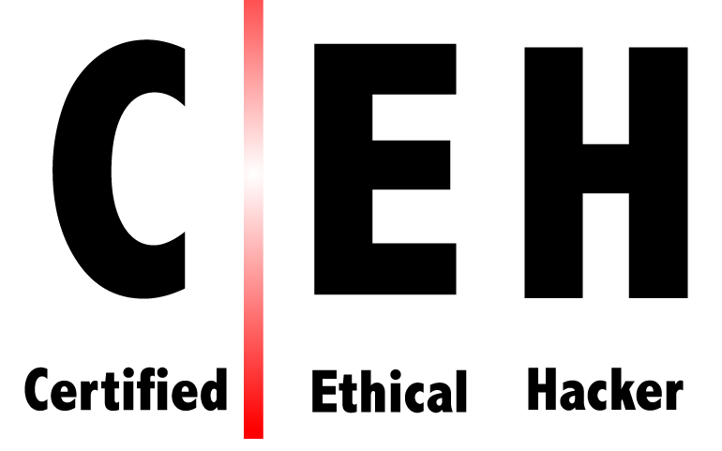

What is CEH?
According to EC-Council:
The Certified Ethical Hacker (CEH) program is the most comprehensive ethical hacking course on the globe to help information security professionals grasp the fundamentals of ethical hacking.
The course outcome helps you become a professional who systematically attempts to inspect network infrastructures with the consent of its owner to find security vulnerabilities which a malicious hacker could potentially exploit.
The course helps you assess the security posture of an organization by identifying vulnerabilities in the network and system infrastructure to determine if unauthorized access is possible.
Notes:
shutterstock_1435284368

Slide 6
As of early 2020, there were almost 12,000 infosec job openings desiring a CEH certification.
‹#›

Slide 7

CEH Roles
Jobs requiring CEH certifications include:
Security Engineers
Security Consultants
Security Analysts
Penetration Testers
Notes:
shutterstock_1614144103

Slide 8
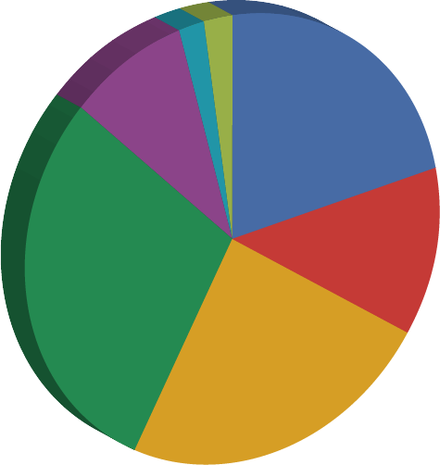
CEH Exam Topics Breakdown
Domain Distribution
2%
2%
01
Background
02
Analysis and Assessment
9%
22%
03
Architecture and Security
04
Tools, Systeems, and Programs
12%
29%
05
Procedures and Methodology
06
Regulation and Policy
24%
07
Ethics

Slide 9
CEH Exam Topics Breakdown
Domain Distribution
Topics include:
01
Background
Communication protocols (HTTP, FTP), telecommunication technologies, backups and archiving
12.0%
02
Analysis and Assessment
Data analysis, risk assessments
21.0%
03
Architecture and Security
Firewalls, cryptography, vulnerabilities, systems security controls
14.0%
04
Tools, Systeems, and Programs
Port scanning (Nmap), vulnerability scanning (Nessus), network sniffers (Wireshark)
05
Procedures and Methodology
16.0%
Security testing methodologies, network routing, security architecture
06
Regulation and Policy
Behavioral requirements for ethical hackers in accordance with laws and policies
15.0%
07
Ethics
Behaving ethically as an offensive security professional

Slide 10

CEH Specs
The CEH certification is obtained by passing the EC-Council administered CEH exam.
While introductory- level, the CEH primarily focuses on offensive security.
The exam contains 125 multiple choice questions and lasts 4 hours.
The cost of the exam is $1,200.
The certification is vendor-neutral.
‹#›
Notes:
Image source: shutterstock_1276756537

Slide 11
CEH Exam Prerequisites
Depending on your experience, you can prepare for the exam in two ways:
01
With Experience
02
Without Experience
If you currently have two years of information security experience, you can self-study for the exam without any formal training.
Your eligibility must be approved by EC-Council with an Exam Eligibility Form.
If you do not have two years of information security experience, you will be required to take official EC-Council training for $850.
Online and in-person courses are available.

Slide 12

CEH Tips
01
Memorize the most common ports and protocols.
02
Use free resources provided by EC-Council, e.g.:
CEH Exam Blueprint
03
Consider taking the EC-Council’s one-week boot camp course to prepare for the exam.
04
The exam is multiple choice, but practicing with hacking tools in virtual environments will help you understand each tool's purpose.
(Source)
Notes:
Image source: Jeevanantham_Jiva

Slide 13
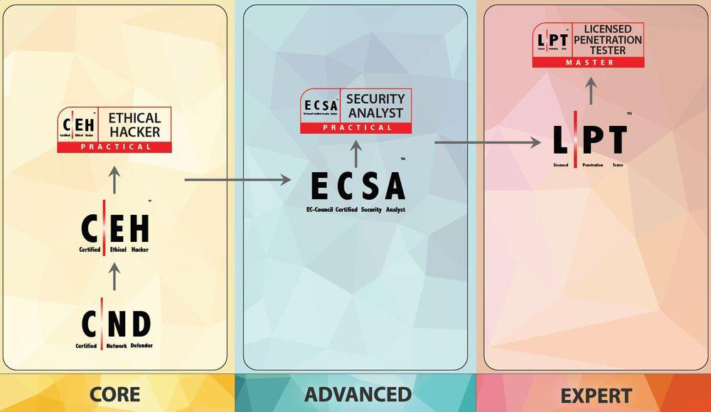
EC-Council’s Other Offerings
The EC-Council offers more advanced practical ethical hacker certifications to complete after CEH.
(Source)

Slide 14

Example Question:
A denial of service or DOS attack is a type of cyberattack where a malicious individual makes system resources unavailable.
This is often accomplished by flooding the system with erroneous requests.
Acme Corp is an organization that just experienced a DOS attack, which of the following is a symptom of this attack?
Acme Corp’s database that contains salary information was modified to provide certain individuals higher salaries.
Acme Corp’s customers are now reporting an error message when trying to access the Acme Corp homepage.
An attacker accessed a copy of Acme Corp's employee list and SSNs.
An attacker was able to successfully launch a SQL injection attack.
Notes:
Image source: shutterstock_1169662366

Slide 15
Example Question:
A denial of service or DOS attack is a type of cyberattack where a malicious individual makes system resources unavailable.
This is often accomplished by flooding the system with erroneous requests.
Acme Corp is an organization that just experienced a DOS attack, which of the following is a symptom of this attack?
Acme Corp’s database that contains salary information was modified to provide certain individuals higher salaries.
Acme Corp’s customers are now reporting an error message when trying to access the Acme Corp homepage.
An attacker accessed a copy of Acme Corp's employee list and SSNs.
An attacker was able to successfully launch a SQL injection attack.
Notes:
Image source: shutterstock_1169662366

Slide 16
Activity: CEH Practice Quiz
In this activity, you will complete sample CEH exam questions.
7 Minutes

Slide 18
CISSP

Slide 19

Certified Information Systems Security Professional (CISSP)
As an advanced certification, many professionals do not attempt this exam until they’ve worked in information security for several years.
As of early 2020, CISSP was the most desired certification, with around
Per (ISC)², the average salary for CISSP jobs is
More than
54,5000
$131,030
129,000
listing it as desired or required.
professionals hold the CISSP certification.

Slide 20
What is CISSP?
According to (ISC)²:
The CISSP is ideal for information security professionals seeking to prove their understanding of cybersecurity strategy and hands-on implementation.
It shows you have the advanced knowledge and technical skills to design, develop and manage an organization’s overall security posture.
Notes:
shutterstock_1435284368

Slide 21




Jobs requiring CISSP certifications may include:
Chief Information Officer
Chief Information Security Officer
Director of Information Security
Security Consultant
Security Analyst
Security Engineer
Notes:
shutterstock_631196210

Slide 22

CISSP Exam Topics Breakdown
01
Security and Risk Management
02
Asset Security
10%
15%
03
Security Architecture and Engineering
04
Communication and Network Security
13%
10%
05
Identity Access and Management
13%
12%
06
Assessment and Testing
07
Security Operations
13%
14%
08
Software Development Security

Slide 23
Domain Distribution
Topics include:
01
Security and Risk Management
Confidentiality, integrity, and availability, business continuity
02
Asset Security
Data security controls, identifying and classifying information and assets
12.0%
21.0%
03
Security Architecture and Engineering
Vulnerabilities in web-based, mobile, and embedded systems, secure design principles
04
Communication and Network Security
Secure network components and architecture
14.0%
05
Identity Access and Management
Physical and logical access security, identification and authentication of services and devices
22.0%
06
Assessment and Testing
Security control testing, security audits
16.0%
07
Security Operations
Incident management, disaster recovery plans
15.0%
08
Software Development Security
Security in the software development lifecycle, security of acquired software

Slide 24
CISSP Specs
The cost of the exam is $699.00
The exam consists of 100-150 questions and is 3 hours long.
The exam uses Computer Adaptive Testing (CAT).
A CAT exam adjusts the questions based on how the test taker performs during the exam.
‹#›
Notes:
Image source: shutterstock_1276756537

Slide 25
CISSP Exam Prerequisites
Depending on your experience, you can prepare for the exam in two ways:
01
CISSP Credentials
02
Associate CISSP Credentials
If you have five years of information security experience in two of the eight domains listed, you can register to take the exam. One year can be replaced with relevant completed education.
After passing the exam, you have nine months to complete your endorsement, in which an (ISC)² certified professional attests to your professional experience.
Once the endorsement is approved by (ISC)² , you will be granted your CISSP credentials.
If you do not have the five years of information security experience in two of the eight domains listed, you can still take the exam.
After passing the exam, you will be granted an Associate CISSP certification.
Once you have met the professional requirements of five years in two of the eight domains, you can begin the endorsement process.

Slide 26
Example Question:
An organization with 130 employees using symmetric encryption is considering moving to asymmetric encryption. How would this affect their number of keys?
260 more keys
8,000 fewer keys
5,605 more keys
8,125 fewer keys
Notes:
Image source: shutterstock_1169662366

Slide 27
Example Question:
An organization with 130 employees using symmetric encryption is considering moving to asymmetric encryption. How would this affect their number of keys?
260 more keys
8,000 less keys
5,605 more keys
8,125 less keys
Symmetric Formula = n(n - 1)/2
130 * 129 / 2 = 8385
Asymmetric Formula = n * 2
130 * 2 = 260
Difference:
8385 - 260 = (D) 8125 fewer keys
Notes:
Image source: shutterstock_1169662366

Slide 28
Activity: CISSP Practice Quiz
In this activity, you will complete sample CISSP exam questions.
7 Minutes

Slide 30

Now we will take part in a fun and challenging competition using

Slide 31

Rules and Guidelines
There are a total of 30 CEH and CISSP questions.
Points are not deducted for incorrect answers.
You have two minutes to answer each question.
If you are competing as a team, select a team captain to answer the questions.
Points are awarded for correct answers and for how quickly you answer the questions compared to your classmates.
Note: If your class is currently online, it will be easier if each student competes individually.
(kahoot.com)

Slide 32
Rules and Guidelines
There will be 15 CEH questions and 15 CISSP questions.
Any issues will be decided by the judges (the TAs and/or instructor).
Issues may include:
Answer disputes
Frozen or lagging computers
Kahoot issues
You can use all available resources: books, the internet, class notes, etc.
The team or individual with the most points at the end of 30 questions will be declared the winner!
(kahoot.com)

Slide 33
Activity: Kahoot Challenge
Now we’ll begin the competition!

